Slide 1


X
Lost in Translation:
Candidate Messaging vs
Voter Reality
September 24, 2025
For informational purposes only. Do Not Distribute. Proprietary information of CinqDI.

Slide 2



Brent Johnson
Political Reporter & Author of NJ.com’s newsletter, “What Makes Jersey Run”
David Beattie
Head of Strategy, CinqDI
AAPC Pollster of the Year
For informational purposes only. Do Not Distribute. Proprietary information of CinqDI.

Slide 3
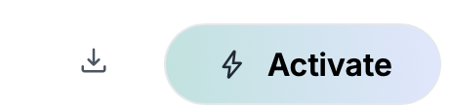
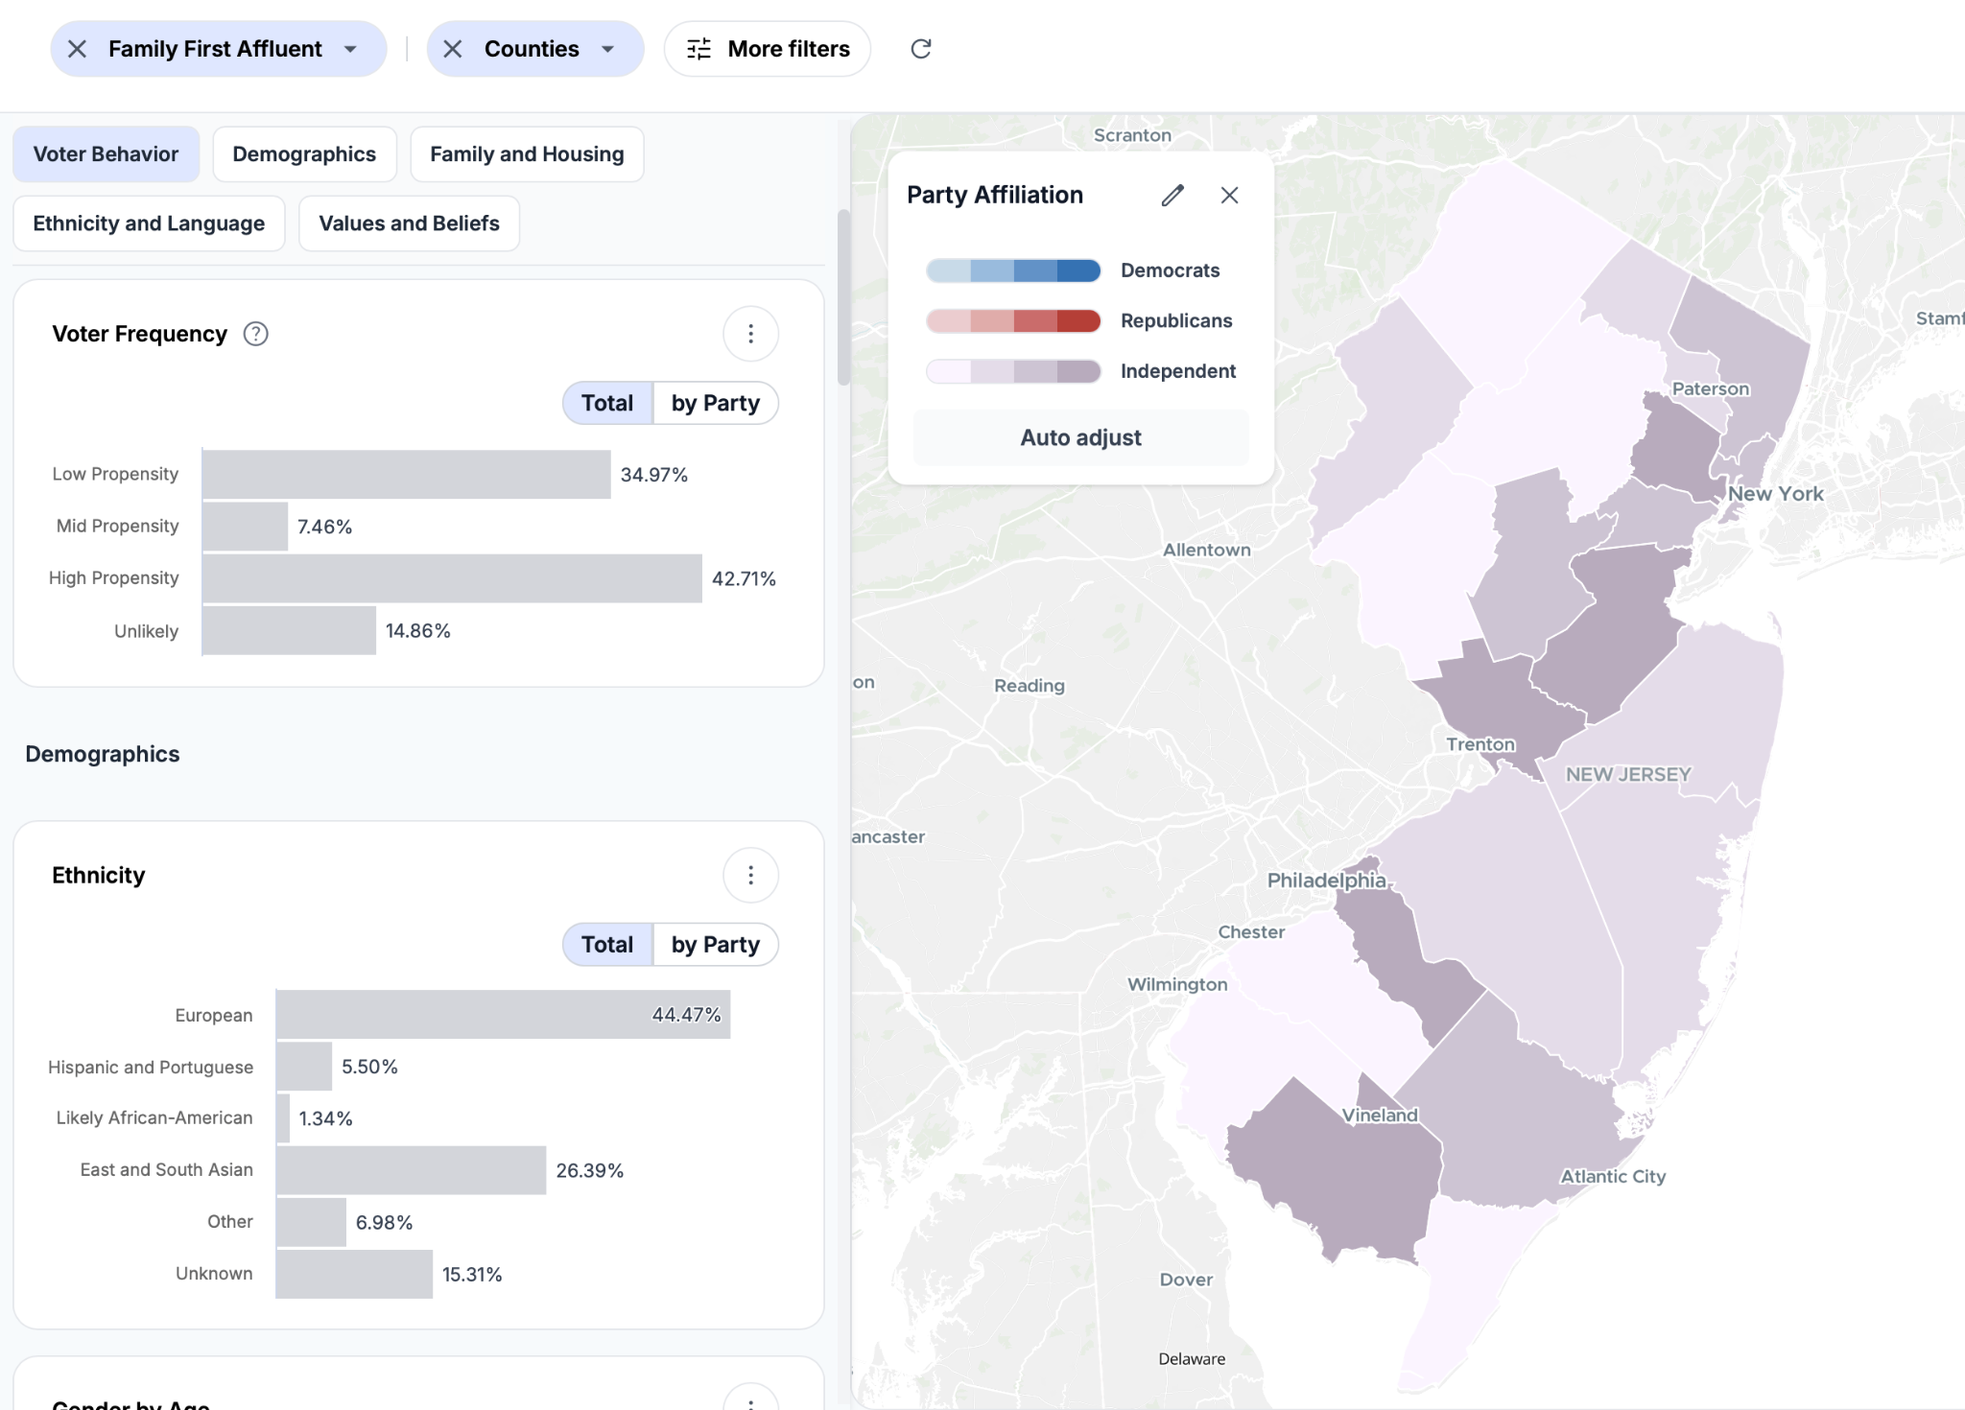
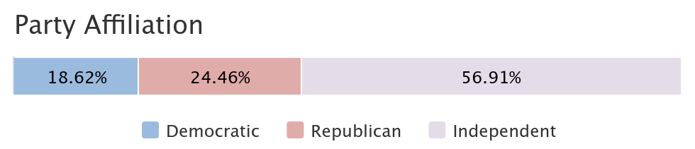
Find Your Audience
492,550 voters
120+ Proprietary, First-Party
Audience Segments
Nationwide Voter File Integration for Deeper Insights
Audience Modeling Based on Engagement
Real-time Visualization of Audience Size, Demographics and Location
For informational purposes only. Do Not Distribute. Proprietary information of CinqDI.

Slide 4
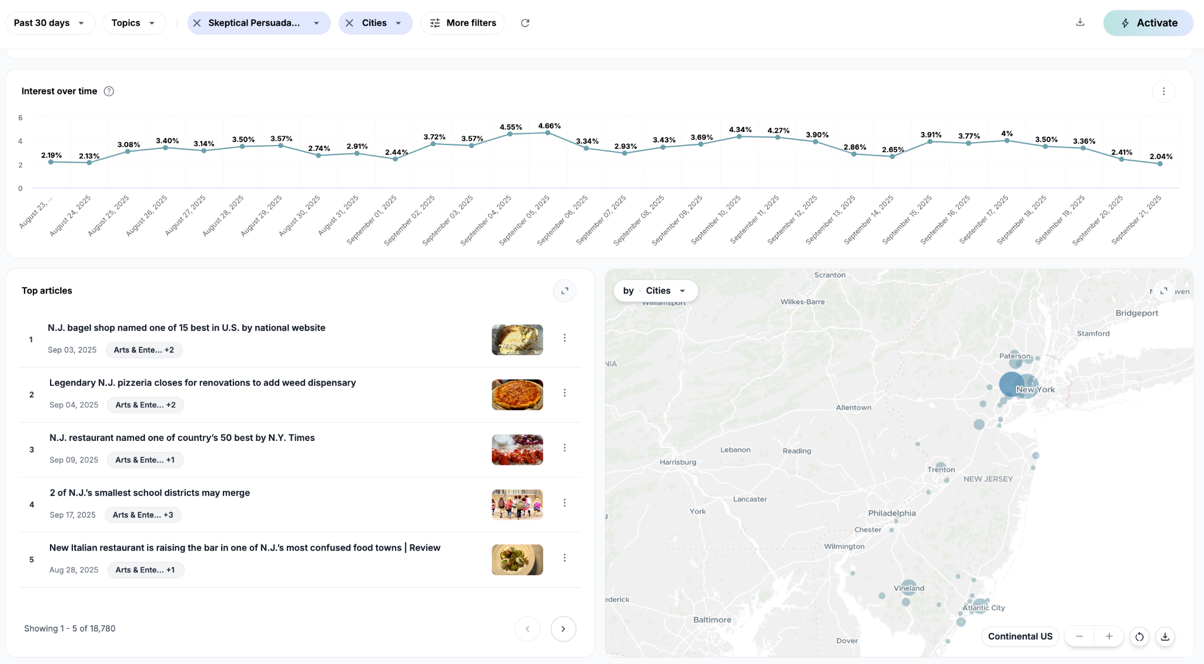
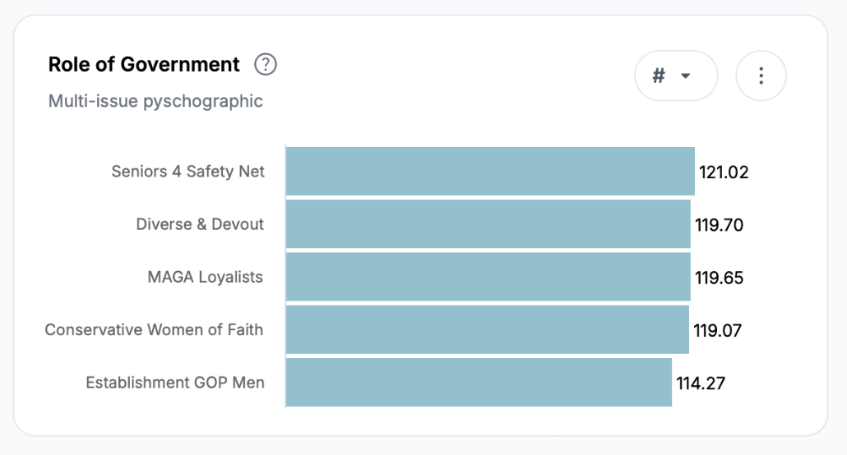
Understand Your Audience’s Behavior
Media Engagement Shows Priorities and Interests
Millions of Interactions Drive Insights
Relies on behavior, not opinion to guide strategy
Indexed to control for demographic bias
For informational purposes only. Do Not Distribute. Proprietary information of CinqDI.

Slide 5
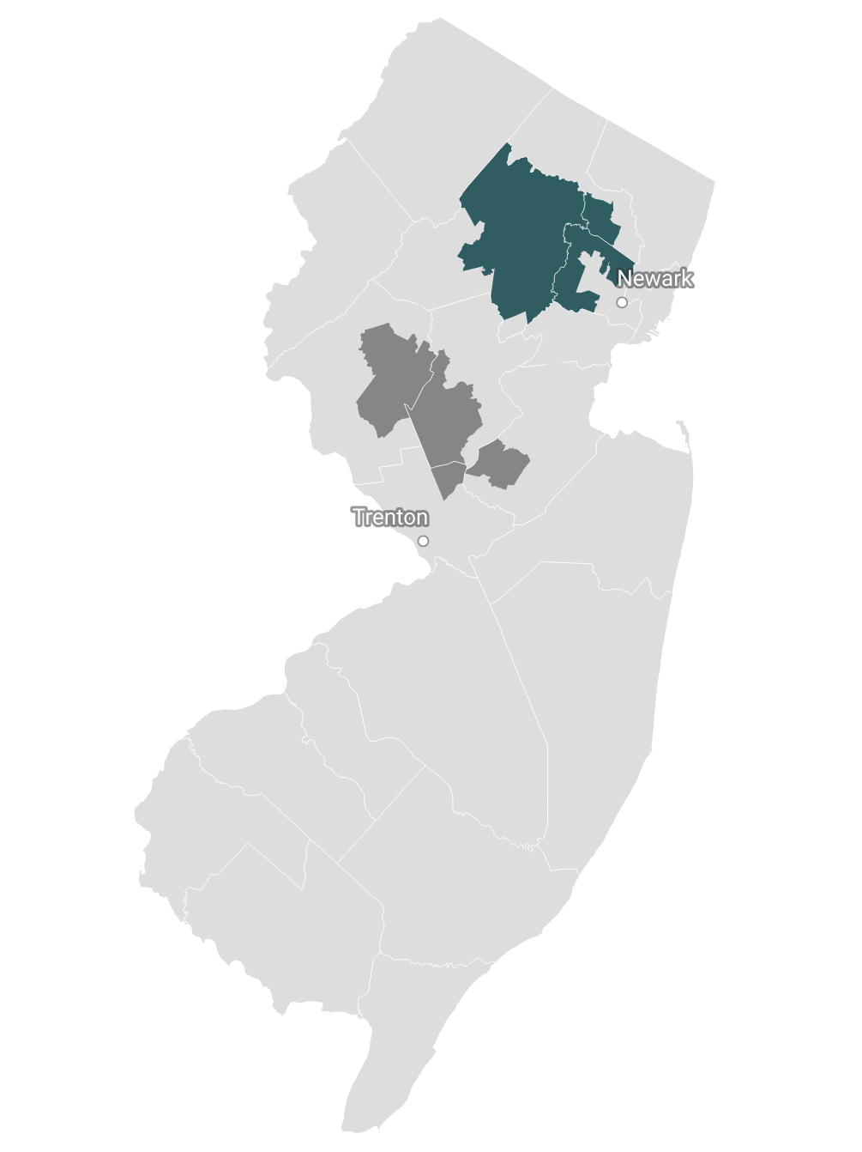
What We Have Learned
MAGA Loyalists (427,803 audience size) | Working Class Progressives (762,395 audience size) | Skeptical Persuadable Women (809,865 audience size)
AUGUST 13th
POST PRIMARY
Behavior Insights
Three Groups STATEWIDE will determine outcome
High turnout & high GOP support
Lowest Turnout, partisan messages do not motivate
Hate Politics
Vote on economic not social issues
Sherrill’s home district
September 10th
55 DAYS UNTIL ELECTION DAY
Behavior Insights
Two key audiences in home districts (NJ SD16 & NJ CD11) shape campaigns
Ciattarelli’s home district
NJ SD16 (164,176 voters)
NJ CD11 (556,674 voters)
Electoral Focus: General Election
Key Demo: Family First Affluent
Why they matter: 22% of voters—nearly 3x statewide
Electoral Focus: Dem Primary
Key Demo: Seniors 4 Safety Net
Why they matter: 43.8% of Primary voters - over 3x district registration
Family First Affluent
Seniors 4 Safety Net
For informational purposes only. Do Not Distribute. Proprietary information of CinqDI.

Slide 6
Sherrill vs Ciattarelli: Prevailing Topics, Frequency and Solutions
Sherrill
Ciattarelli
Rank (Frequency) | Topic | Offered Solution
1 | Utility/Energy Costs | Declare emergency, freeze rates, boost nuclear/solar, regulate utilities, take PJM (grid) to court
2 | Taxes/ Affordability | Streamline business, cut red tape, new development for transit funding, avoid corporate transit fee
3 | Economic Growth/Jobs | Business support, streamline licensing, “Save You Time and Money Agenda”
4 | Education | Expand mental health in schools, modernize, protect funding from federal cuts
5 | Democracy/ Trump | Position as defender against “Trump agenda”, restore democracy, voting rights
Rank (Frequency) | Topic | Offered Solution
1 | Taxes/ Affordability | Lower/cap property tax, reduce income and payroll taxes, cut government spending
2 | Education | Emphasize “basics”, toughen curriculum, school choice/vouchers, support for parents’ rights
2 | Utility/Energy Costs | Exit RGGI, open power plants, repurpose for natural gas, expand nuclear, reduce regulation
3 | Crime/Public Safety | Appoint AG supportive of police, end sanctuary policies, reform bail, tough-on-crime
4 | Economic Growth/Jobs | Lower business taxes, cut regulation, “franchise universities”, help small business
Sources: Recent speeches, debates & social media
For informational purposes only. Do Not Distribute. Proprietary information of CinqDI.

Slide 7
Sherrill vs Ciattarelli: Energy
Sherrill
Ciattarelli
“President Trump [is] rolling back some of the initiatives on solar or adding $250 per family to your energy bill.”
“Let's think about talk about what the president has done for New Jersey since he took office. He's put a temporary halt on wind farms off the Jersey shore. I'll make that permanent.”
“I'm going to freeze those rate hikes by declaring a state of emergency. I'm going to add massive amounts of power into the grid.”
“And we're pulling out of the regional greenhouse gas initiative. That carbon tax initiative has been a failure. Air's no cleaner. Electricity is only more expensive.”
“I'll instruct my attorney general to take on our grid operator PJM and Donald Trump to court to force them to end their mismanagement and get new power added to the grid.”
“When Phil Murphy took office, we had six additional electricity generation plants that he has closed down. He didn't expand our nuclear footprint in South Jersey. He didn't accelerate solar. And where are we today? Energy shortage.”
Sources: Recent speeches, debates & public appearances
For informational purposes only. Do Not Distribute. Proprietary information of CinqDI.

Slide 8
The Battleground: Two Key Audiences Emerge
With both parties locked in, the path to victory runs through Independents. Two decisive audiences — Family First Affluent and Skeptical Persuadable Women — hold the key, representing 20% of New Jersey’s electorate.
Family First Affluent
492,550 voters in NJ 56% are Independents
Skeptical Persuadable Women
784,439 voters in NJ 48% are Independents
11% voted in the NJ Gubernatorial Primary - about half of the statewide turnout rate
11% voted in the NJ Gubernatorial Primary - about half of the statewide turnout rate
Emphasize education quality and accountability, community impact, and consumer protections on utilities to build trust and engagement.
Focus on family‑impact school changes, local safety, and practical affordability solutions like bill relief to resonate authentically

Slide 9
Top Readership Theme in Last 30 Days for Key Audiences:
Education
Family First Affluent
Skeptical Persuadable Women
Rank (Share of top 50 headlines) | Theme
1 (36% of top 50 headlines) | Education & Schools
2 (22% of top 50 headlines) | Community & Local News
3 (20% of top 50 headlines) | Food & Dining
4 (14% of top 50 headlines) | Crime & Public Safety
5 (8% of top 50 headlines) | Human Interest & Family
Tone: Informed, evaluative, concerned
Focus: Student outcomes (SAT scores, performance rankings), teacher pay, funding efficiency, and quality of education.
Key Lens: “Are schools delivering excellence and upholding standards?”
Framing: Emphasis on transparency, quality benchmarks, and making sure systems deliver results worthy of investment.
Rank (Share of top 50 headlines) | Theme
1 (36% of top 50 headlines) | Education & Schools
2 (22% of top 50 headlines) | Food & Dining
2 (22% of top 50 headlines) | Crime & Public Safety
3 (8% of top 50 headlines) | Community & Local News
4 (4% of top 50 headlines) | Local Govt & Policy
Tone: Concerned, critical, inquisitive
Focus: Emotional reactions from parents and teachers to disruptive changes (start times, curriculum overhauls, teacher pay).
Key Lens: “How will this impact families day-to-day, and why weren’t we consulted?”
Framing: School decisions are surprising or poorly communicated; readers are focused on fairness and disruption.
Source: CinqDI, Aug 21 - Sept 21, 2025
For informational purposes only. Do Not Distribute. Proprietary information of CinqDI.

Slide 10
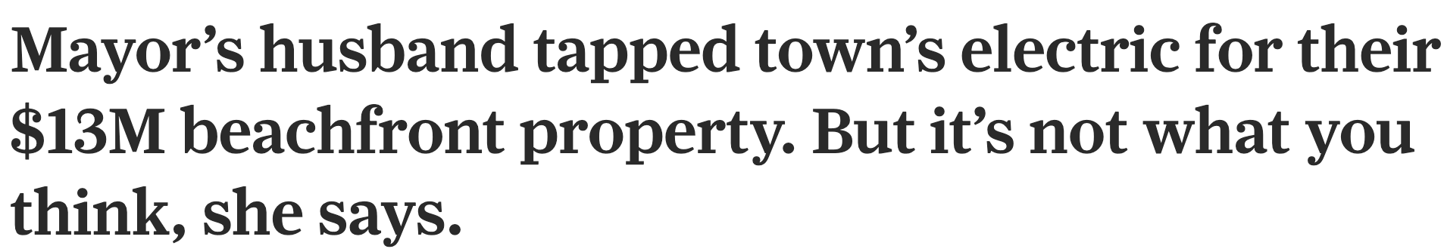
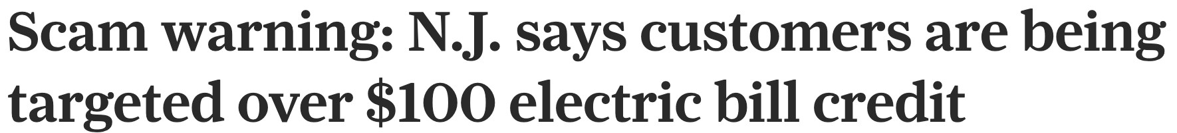
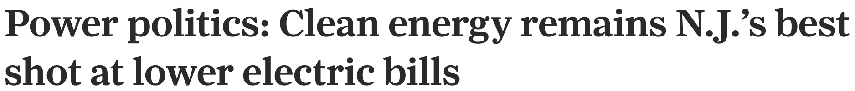
How Skeptical Persuadable Women vs Family First Affluent Engage with Energy/Utility News in Last 30 Days
Shared Interests
Rising electricity bills and affordability
Relief measures (credits, rebates)
Utility accountability & scams
TOP THREE ENERGY HEADLINES FOR BOTH GROUPS, LAST 30 DAYS
Family First
Affluent
Skeptical Persuadable Women
Tone: informed, evaluative, accountability-focused
Focus on utility mismanagement, consumer protections, and infrastructure reform
Tone: concerned, critical, reactive
Focus on bill shock, political blame, and clean energy controversies
Source: CinqDI, Aug 15 - Sept 15, 2025
Source: CinqDI, Aug 21 - Sept 21, 2025
For informational purposes only. Do Not Distribute. Proprietary information of CinqDI.
Notes:
On CinqDI, using the keywords: utility, solar, natural gas, clean energy, energy cost, electric bills, energy utility, energy utilities, offshore, and electricity, we analyzed the top 30 headlines each read by Skeptical Persuadable Women and Family First Affluent over the past 30 days to understand how these audiences are engaging with energy news.

Slide 11
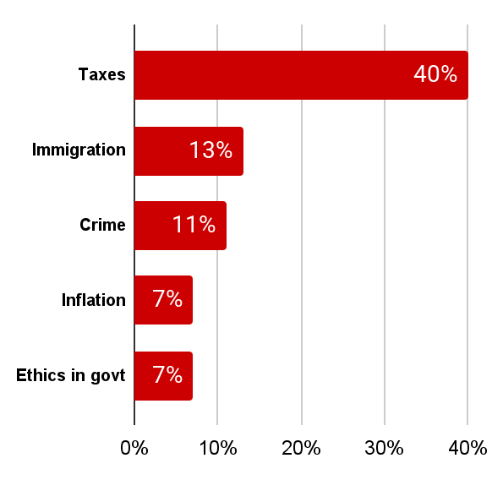
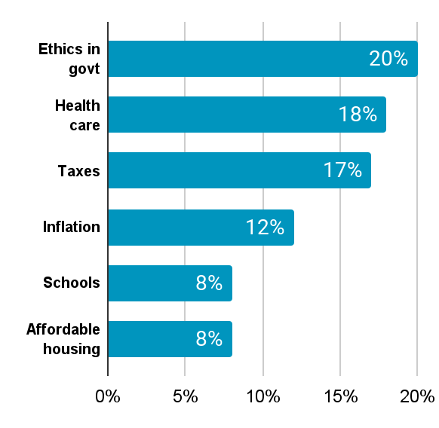
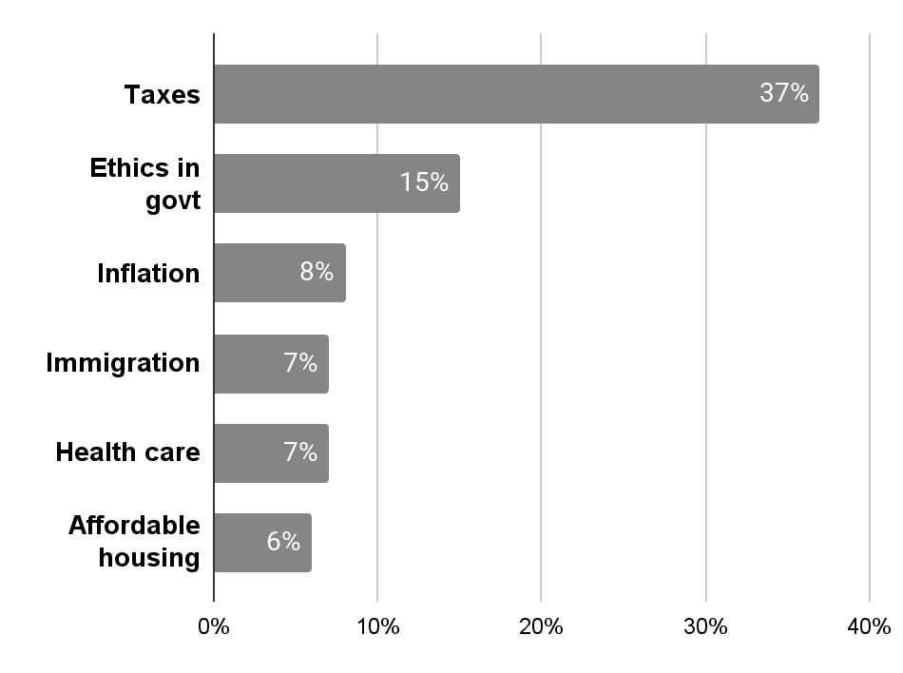
According to Recent Poll: Most Important Issue for GOP is Taxes; Dems is Ethics in Govt, Closely Followed by Health Care & Taxes
Which is the most important issue to you in deciding who to vote for in the election for governor? taxes, inflation, immigration, crime, unemployment, health care, schools, electricity costs, affordable housing, mass transit, or ethics in government? (top 5 issues below)
REP
DEM
IND
Source: Quinnipiac University
For informational purposes only. Do Not Distribute. Proprietary information of CinqDI.

Slide 12
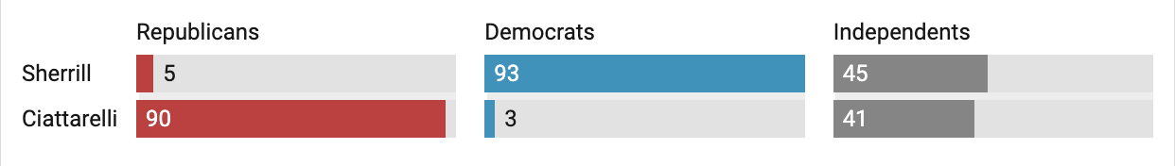
The Battleground: Independents
Statewide Total (If Elections Were Being Held Today)
Sherrill - 49% Ciattarelli - 41% Undecided/Refused - 6% Other - 2%
8% margin & 8% = undecided/ refused/other
If the Governor’s race were held today, party loyalty is strong on both sides: 90% of Republicans back Ciattarelli and 93% of Democrats back Sherrill. The real divide emerges among Independents, with 45% supporting Sherrill and 41% supporting Ciattarelli.
Likely Voters - NJ Governor’s Race
Source: Quinnipiac University
For informational purposes only. Do Not Distribute. Proprietary information of CinqDI.

Slide 13
Issue Alignment Between Candidates Messaging and Key Audiences Readership Interests (Top 6)
Topic/ Theme | FFA & SPW Interest | Sherrill Rank | Sherrill Focus | Ciattarelli Rank | Ciattarelli Focus | Candidate & Audience Overlap
Education | High | 4 | Modernize, mental health, funding | 2 | Basics, choice, parent rights | Overlap, but different lense
Lifestyle/ Community | High | 3 | Limited, economy/jobs | 4 | Limited, economy/jobs | Disconnect, opportunity
Crime/Public Safety | High | __ | Support law enforcement | 3 | Tough-on-crime, anti-sanctuary | Overlap, Ciattarelli more vocal
Taxes/ Affordability | High | 2 | Lower costs, streamline business | 1 | Cut/cap taxes, shrink gov | Strong overlap through the lens of education & schools
Energy/ Utilities | Moderate-High | 1 | Deregulate, expand conventional + solar, nuclear | 2 | Reform, oppose progressive | Some overlap, but less audience focus (doesn’t rank in top 5 readership themes)
Local Gov/Policy | Moderate | 5 | Accountability, transparency | — | Reform, oppose progressive | Overlap, opportunity for more focus
For informational purposes only. Do Not Distribute. Proprietary information of CinqDI.

